Slide 1


Leclère et al. 2020: Bending the curve of terrestrial biodiversity needs an integrated strategy

Slide 2
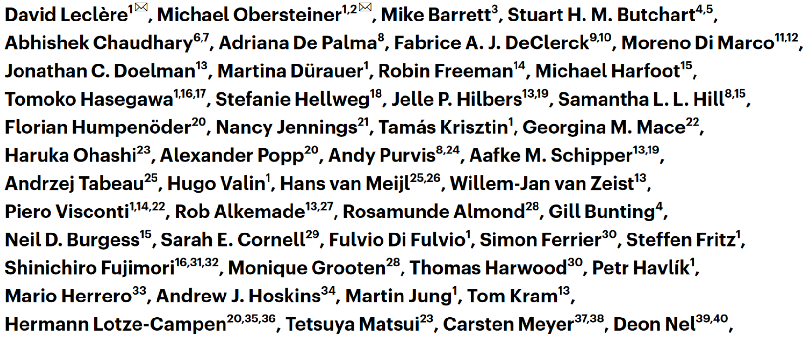
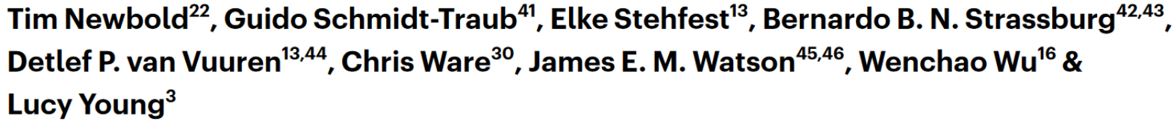

Slide 3
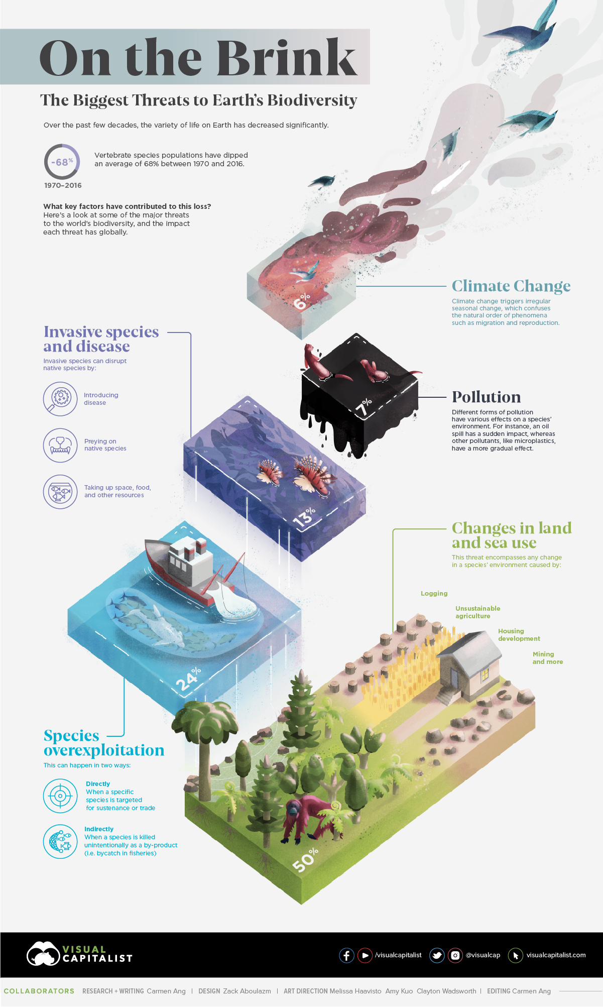
Notes:
From https://www.visualcapitalist.com/biggest-threats-to-earths-biodiversity/
Based on WWF Living Planet Report 2020

Slide 4
What is biodiversity?
And how do we measure it?
Notes:
So, what do you think biodiversity is?
→ # of individuals, # of species, genes?...
What do you think which indicators could be useful?
→ # of butterflies, # of fish species in a river, size of distribution range? How to measure ecosystem functioning? Would nutrient availability count as biodiversity indicator?

Slide 5

vs
Notes:
Ambitious biodiversity targets which could potentially conflict with food provision and other land uses
Study aim: Provide guidance for developing a biodiversity strategy that is consistent with SDGs. Do so using a multi-model ensemble approach

Slide 6




Notes:
Only habitat destruction + degradation considered
Not: climate change, invasive species or others
And: only terrestrial ecosystems are considered!

Slide 7
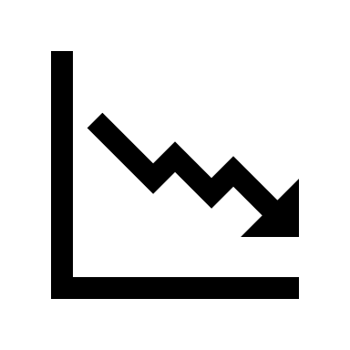
Supply
Demand
Conservation

Slide 8
Scenarios | Additional efforts to reverse trends in biodiversity
 | Supply side |  | Demand side |  | Increased conservation
 | Sustainably increased crop yields | Increased trade of agricultural goods | Reduced waste of agricultural goods from field to fork | Diet shift to a lower share of animal calories | Increased extent and management of protected areas | Increased restoration and landscape-level conservation planning
Notes:
BASE, RCPref_SSP2_NOBIOD; SS, RCPref_SSP1pTECHTADE_NOBIOD; DS, RCPref_SSP1pDEM_NOBIOD; C, RCPref_SSP2_BIOD; C + SS, RCPref_SSP1pTECHTADE_BIOD; C + DS, RCPref_SSP1pDEM_BIOD; IAP, RCPref_SSP1p_BIOD
Based on http://pure.iiasa.ac.at/id/eprint/17565/

Slide 9
Scenarios | Additional efforts to reverse trends in biodiversity
 | Supply side |  | Demand side |  | Increased conservation
 | Sustainably increased crop yields | Increased trade of agricultural goods | Reduced waste of agricultural goods from field to fork | Diet shift to a lower share of animal calories | Increased extent and management of protected areas | Increased restoration and landscape-level conservation planning

Slide 10
Scenarios | Additional efforts to reverse trends in biodiversity
 | Supply side |  | Demand side |  | Increased conservation
 | Sustainably increased crop yields | Increased trade of agricultural goods | Reduced waste of agricultural goods from field to fork | Diet shift to a lower share of animal calories | Increased extent and management of protected areas | Increased restoration and landscape-level conservation planning

Slide 11
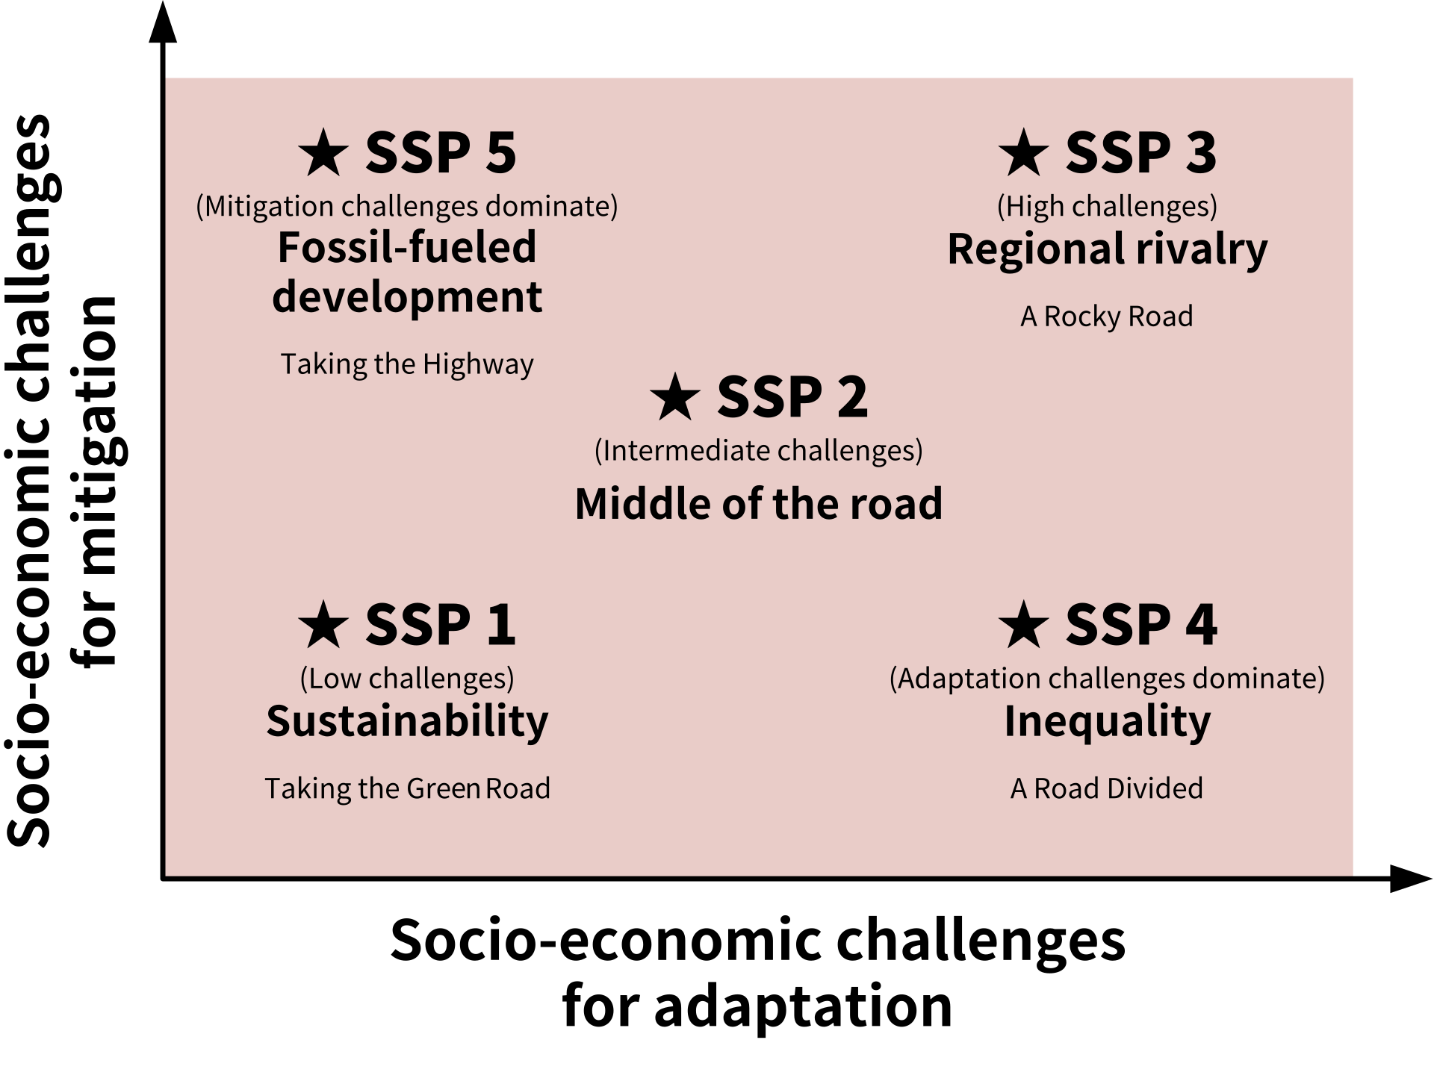
Scenarios | Additional efforts to reverse trends in biodiversity
 | Supply side |  | Demand side |  | Increased conservation
 | Sustainably increased crop yields | Increased trade of agricultural goods | Reduced waste of agricultural goods from field to fork | Diet shift to a lower share of animal calories | Increased extent and management of protected areas | Increased restoration and landscape-level conservation planning
Baseline scenario
BASE scenario | − | − | − | − | − | −
=SSP2
Notes:
Middle of the road: 9.4 bil people by 2070, moderate&uneven economic growth, slow socio-economic convergence between countries. Dietary preferences, trade, agric. productivity as before

Slide 12
Scenarios | Additional efforts to reverse trends in biodiversity
 | Supply side |  | Demand side |  | Increased conservation
 | Sustainably increased crop yields | Increased trade of agricultural goods | Reduced waste of agricultural goods from field to fork | Diet shift to a lower share of animal calories | Increased extent and management of protected areas | Increased restoration and landscape-level conservation planning
Baseline scenario
BASE scenario | − | − | − | − | − | −
Single-action scenarios
SS scenario | x | x | − | − | − | −
DS scenario | − | − | x | x | − | −
C scenario | − | − | − | − | x | x
≈SSP1
+ conser-vation
Notes:
Green growth
Single action + combined action bundles that increase in intensity gradually from 2020 – 2050
SS follows SSP1 strictly, while DS is more ambitious than SSP1.
C: New qualitative + quantitative elements being more ambitious than SSPs: Protection efforts increased from 2020 in all land areas that are currently protected or identified as conservation priority areas; progressive increase in restoration efforts

Slide 13
Scenarios | Additional efforts to reverse trends in biodiversity
 | Supply side |  | Demand side |  | Increased conservation
 | Sustainably increased crop yields | Increased trade of agricultural goods | Reduced waste of agricultural goods from field to fork | Diet shift to a lower share of animal calories | Increased extent and management of protected areas | Increased restoration and landscape-level conservation planning
Baseline scenario
BASE scenario | − | − | − | − | − | −
Single-action scenarios
SS scenario | x | x | − | − | − | −
DS scenario | − | − | x | x | − | −
C scenario | − | − | − | − | x | x
Combined-action scenarios
C + SS scenario | x | x | − | − | x | x
C + DS scenario | − | − | x | x | x | x
IAP scenario | x | x | x | x | x | x

Slide 14
spat./temp. resolved projections for each scenario
IAMs
4
scenarios
7
4
9
biodiversity indicators, covering 5 aspects with 6 metrics
8
BDM evaluations
Notes:
Outputs from IAM land-use components were evaluated using 8 biodiversity models

Slide 15


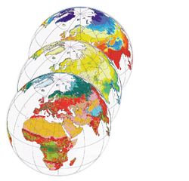

spat./temp. resolved projections for each scenario
2010-2100
30 (5) arcmin res.
12 land use classes
4
IAMs
4
AIM-B
INSIGHTS
LPI-M
GLOBIO
PREDICTS
cSAR_CB17
cSAR_US16
BILBI
Extent of suitable habitat
Wildlife population density
Intactness of local sp. comp.
Regional extinctions
Global extinctions
9
biodiversity indicators, covering 5 aspects with 6 metrics
8
BDM evaluations
WDPA
IUCN ranges
KBA
LUH2
HYDE 3.1
bad
[0; >1)
good
Notes:
MESSAGE-GLOBIOM, REMIND-MAgPIE, AIM-CGE, IMAGE-MAGNET
built-up area, cropland other than short-rotation bioenergy plantations, cropland dedicated to short-rotation bioenergy plantations, managed grassland, managed forest, unmanaged forest, other natural vegetation, restoration land, abandoned cropland previously dedicated to crops other than short-rotation bioenergy plantations, abandoned cropland previously dedicated to short-rotation bioenergy plantations, abandoned managed grassland and abandoned managed forest
Extent of suitable habitat → ESH = Extent of suitable habitat
Wildlife population density → LPI = Living planet index
Intactness of local sp. comp. → MSA = Mean species abundance
→ BII = Biodiversity intactness index
Regional extinctions → FRRS = Fraction of regionally remaining species
Global extinctions → FGRS = Fraction of globally remaining species
!!! All relative measures, i.e. [0;1] and sometimes >1 if fewer species are extinct/ populations sizes are larger/ composition closer to undisturbed state/ habitat extent is bigger. =1 if same as in 2010
WDBA = World database of protected areas
IUCN species range maps
KBA = World database of key bodiversity areas
LUH2 = Land use harmonization ²
HYDE = History database of the Global Environment

Slide 16
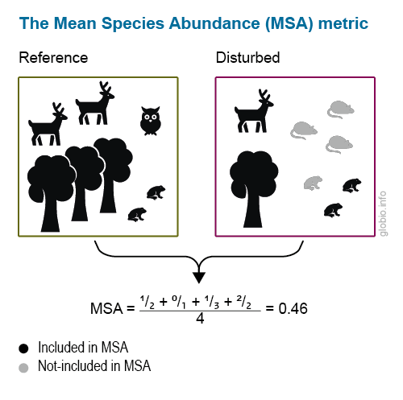
Source: https://www.globio.info/what-is-globio
Notes:
The Mean Species Abundance (MSA) metric is an indicator of local biodiversity intactness. MSA ranges from 0 to 1, where 1 means that the species assemblage is fully intact, and 0 means that all original species are extirpated (locally extinct). MSA is calculated based on the abundance of individual species under influence of a given pressure, compared to their abundance in an undisturbed situation (natural situation/reference). Only species present in the undisturbed situation are included, and increases in individual species abundance from the reference to the impacted situation are ignored. This is done to avoid the indicator being inflated by opportunistic or generalist species that benefit from habitat disturbance.
For example, in the picture below, three species decrease in abundance (tree, deer and owl) and two show an increase (frog, rodent). As new species and abundance increases do not count, the MSA is calculated as the mean of the abundance ratios of the four species in the reference situation, whereby the increase in frog abundance is ignored.

Slide 17


Slide 18
“Estimating future trends in biodiversity for all seven scenarios, ten time horizons and four IAMs was not possible for all BDMs.”

Slide 19
IAP: halted 2050 + subsequent recovery + non-biodiv. benefits
Only conservation insufficient
Food system transf. required
Full reversal requires add. interventions
Cont‘d global biodiv. decline
Rates of biodiv. losses: 2010-2050 ≥ 1970-2010
Percentage losses were greatest in biod.-rich regions

Slide 20
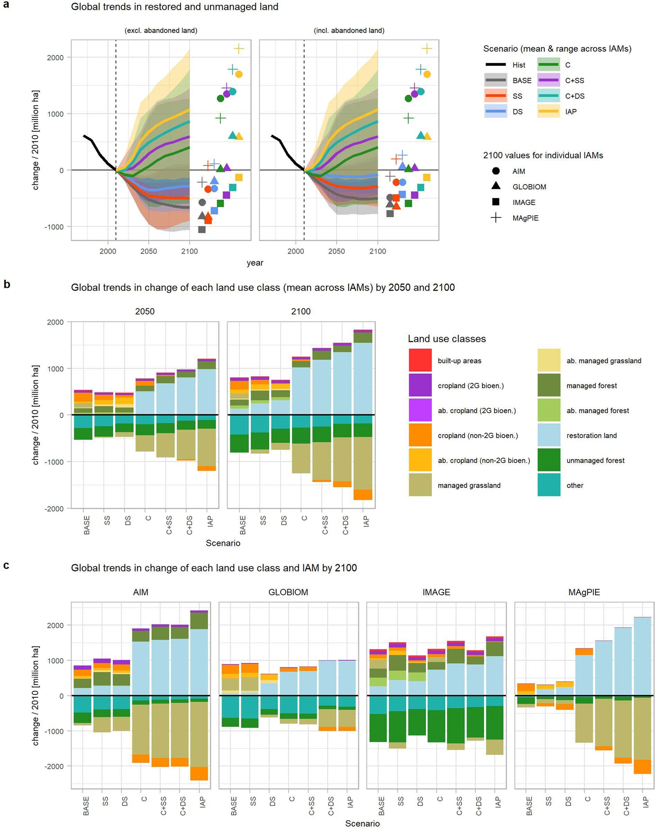
Notes:
Extended Data Fig. 4: Projected global trends in land-use change across all scenarios.
a, Global trends in the sum of restored land, unmanaged forest and other natural land classes compared to 2010 (with and without excluding the land abandoned and not yet in restoration—different only for scenarios without increased conservation efforts; Methods). Thick lines show the average values across all four IAMs; shading shows the range across IAMs. b, c, Global changes projected in the area of each of the 12 land-use classes (compared to 2010) for the seven scenarios averaged across the four IAMs by 2050 and 2100 (b), and for each individual IAM by 2100 (c).

Slide 21
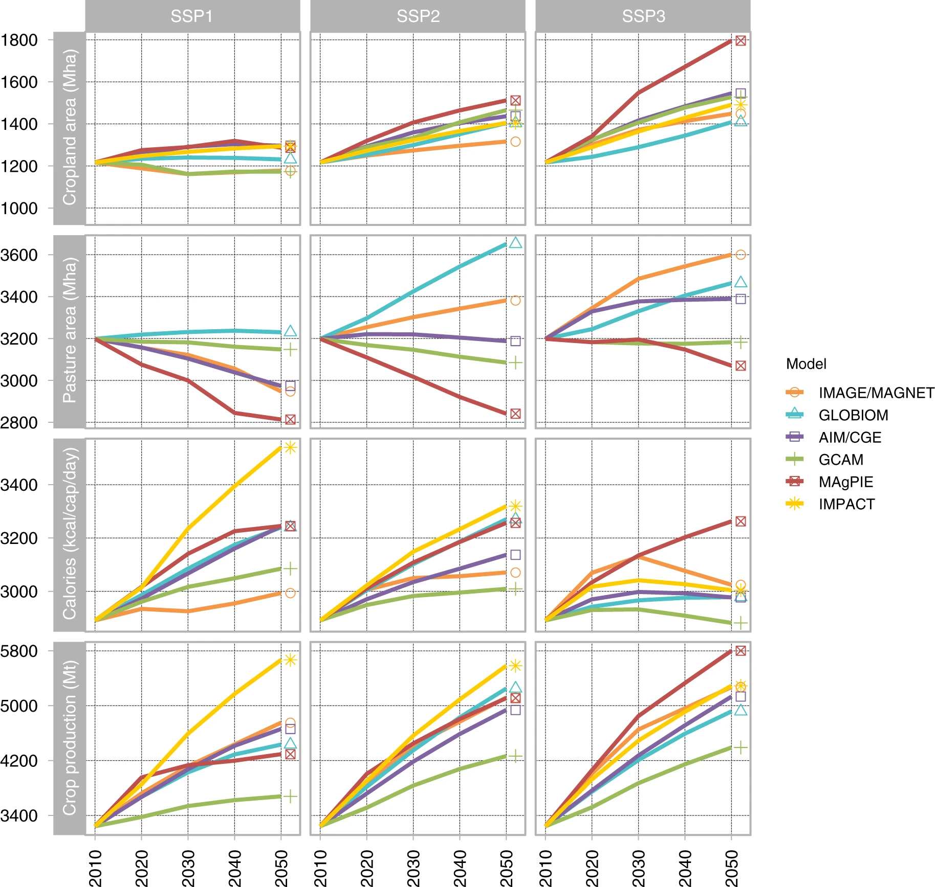
From land use paper by Stehfest et al., 2019
Notes:
Extended Data Fig. 4: Projected global trends in land-use change across all scenarios.
a, Global trends in the sum of restored land, unmanaged forest and other natural land classes compared to 2010 (with and without excluding the land abandoned and not yet in restoration—different only for scenarios without increased conservation efforts; Methods). Thick lines show the average values across all four IAMs; shading shows the range across IAMs. b, c, Global changes projected in the area of each of the 12 land-use classes (compared to 2010) for the seven scenarios averaged across the four IAMs by 2050 and 2100 (b), and for each individual IAM by 2100 (c).

Slide 22
And the biodiversity?

Slide 23
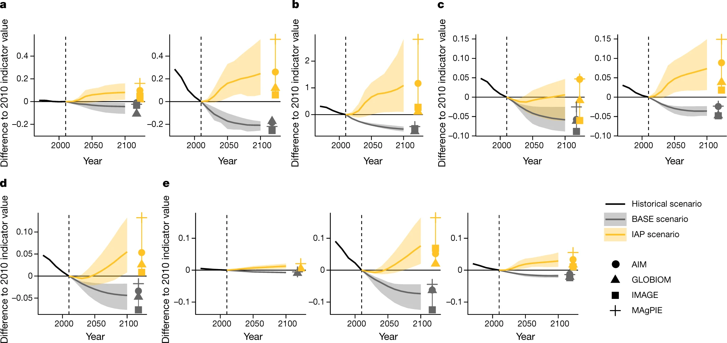
Fraction of globally remaining species
BILBI (left), cSAR_CB17 (middle), cSAR_US16 (right)
Notes:
Fig. 1: Estimated recent and future global biodiversity trends resulting from land-use change, with and without coordinated efforts to reverse trends.
a–e, The trends for the five aspects of biodiversity that result from changes in nine BDIs (Table 2). BDI values are shown as differences from the 2010 value (which was set to 1); a value of −0.01 means a 1% loss in the respective BDI.
e, The global number of species not already extinct or committed to extinction (measured using the fraction of globally remaining species metric, estimates from the BILBI (left), cSAR_CB17 (middle) and cSAR_US16 (right) BDMs are shown). BDI values are projected in response to land-use change derived from one source over the historical period (1970–2010, black line (IMAGE/HYDE 3.1)) and from four IAMs (AIM, GLOBIOM, IMAGE and MAgPIE; lines display the mean of all models; shading shows the range of all models) for the BASE scenario (grey) and IAP scenario (yellow) (Table 1) over the future period (2010–2100). 2010 is indicated with a vertical dashed line. 2100 values for individual IAMs are shown as different symbols.

Slide 24
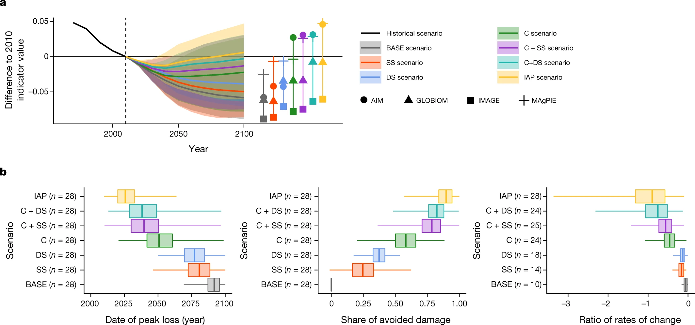
Intactness of local species composition
MSA metric (GLOBIO; 1/28 of BDI+IAM)
Conservation!
Notes:
Fig. 2: Contributions of various efforts to reverse land-use change-induced biodiversity trends
Future actions towards reversing biodiversity trends vary across the seven scenarios (BASE, SS, DS, C, C + SS, C + DS and IAP).
a, The line for each future scenario represents the mean across four IAMs and the shading represents the range across four IAMs of future changes (compared with 2010) for one illustrative biodiversity metric (MSA) estimated by one biodiversity model (GLOBIO). For the historical period, the black line represents the changes projected in the same biodiversity metric for the single land-use dataset considered over this period. Symbols show the estimated changes by 2100 for individual IAMs.
b, Estimates of the distribution across combinations of BDIs and IAMs, for each scenario. Left, the date of the twenty-first century minimum date of peak loss. Middle, the proportion of peak biodiversity losses that could be avoided compared with the BASE scenario. Right, the speed of recovery after the minimum has been reached. Data were normalized by the historical speed of change, so that a value of −1 means recovery at the speed at which biodiversity losses took place in 1970–2010; values lower than −1 indicate a recovery faster than the 1970–2010 loss. Values are estimated from 10,000 bootstrap samples from the original combination of BDIs and IAMs. In each box plot, the vertical bar indicates the mean estimate (across bootstrap samples) of the mean value (across BDI and IAM combinations), the box indicates the 95% confidence interval of the mean value and the horizontal lines indicate the mean estimates (across bootstrap samples) of the 2.5th and 97.5th percentiles (across BDI and IAM combinations). The estimates are based on bootstrap samples with n = 28 (7 BDIs × 4 IAMs), except in the right panel, for which n ≤ 28, as the speed of recovery after peak loss is not defined if the peak loss is not reached before 2100

Slide 25
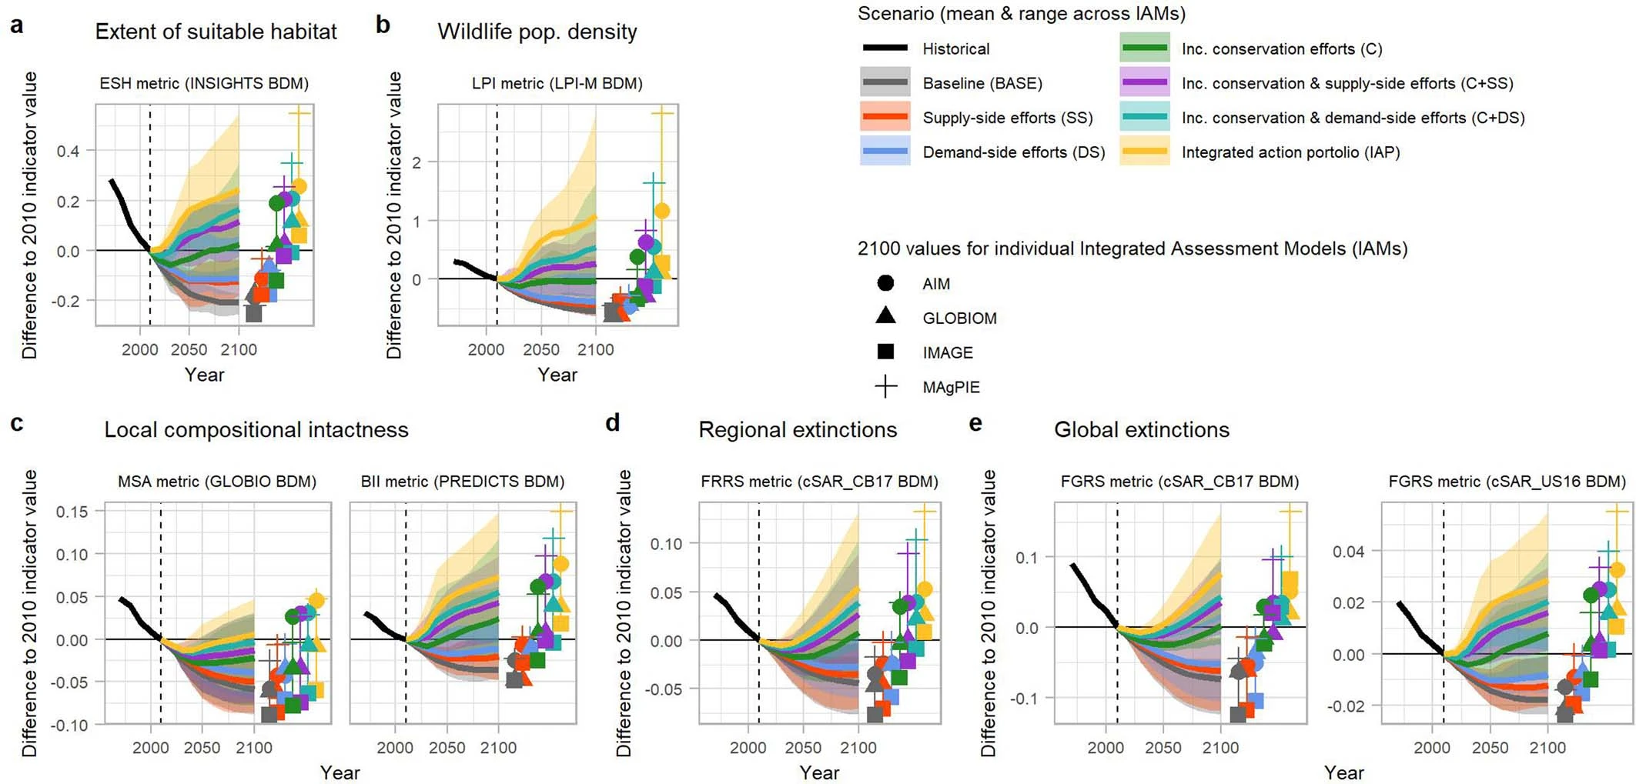

Slide 26
Thanks!

Slide 27
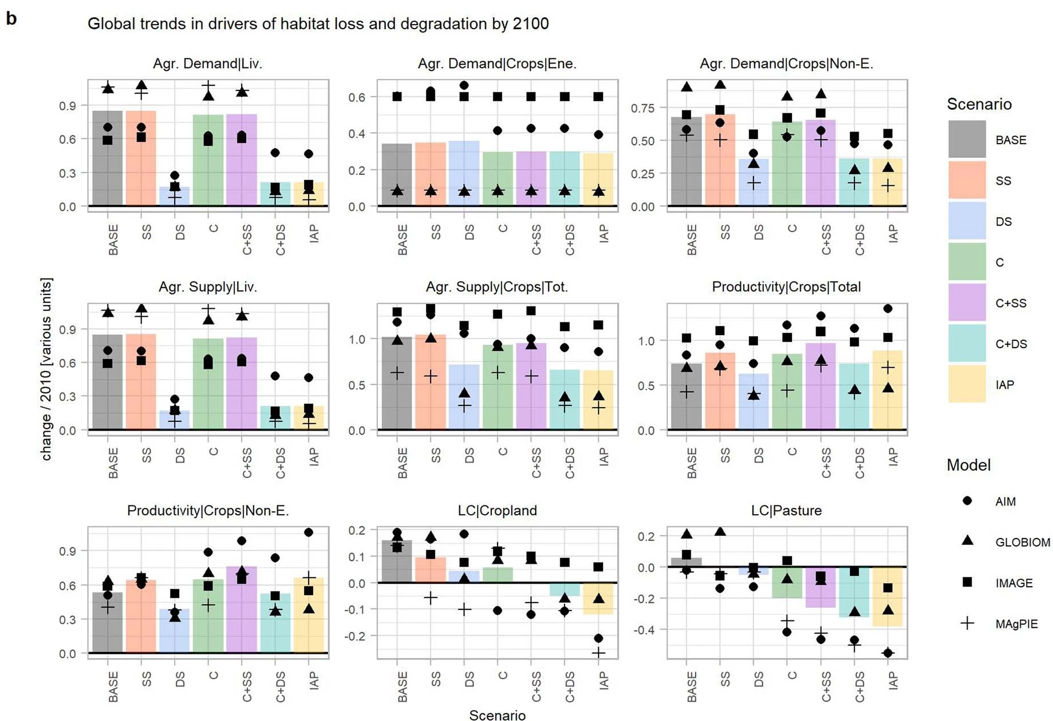
Notes:
Extended Data Fig. 3 Projected future global trends in drivers of habitat loss and degradation.
a, b, For each scenario (colours, mean across all four IAMs), the relative change from 2010 to 2050 (a) and 2100 (b) in nine variables are shown. The symbols indicate the IAM-specific values. The variables displayed from the top left to bottom right are: agricultural demand for livestock products (Agr. Demand|Liv.), agricultural demand for short-rotation bioenergy crops (Agr. Demand|Crops|Ene.), agricultural demand for crops other than short-rotation bioenergy crops (Agr. Demand|Crops|Non-E.), agricultural supply of livestock products (Agr. Supply|Liv.), agricultural supply of all crop products (Agr. Supply|Crops|Tot.), average yield of crops other than short-rotation bioenergy crops (in metric tonnes dry matter per hectare, Productivity|Crops|Non-E.), and the land dedicated to cropland (LC|Cropland) and pasture (LC|Pasture). Values displayed for each variable are change relative to the value of the same variable simulated for 2010, except for two variables (Agr. Demand|Crops|Ene. and Agr. Demand|Crops|Non-E.), for which the change in each of the variables is normalized to the sum of values simulated in 2010 for the two variables (that is, normalization to the total demand for crops).

Slide 28
Notes:
Fig. 1: Estimated recent and future global biodiversity trends resulting from land-use change, with and without coordinated efforts to reverse trends.
a–e, The trends for the five aspects of biodiversity that result from changes in nine BDIs (Table 2). BDI values are shown as differences from the 2010 value (which was set to 1); a value of −0.01 means a 1% loss in the respective BDI. a, The extent of suitable habitat (measured using the extent of suitable habitat metric; estimates from AIM-B (left) or INSIGHTS (right) BDMs are shown). b, The wildlife population density (measured using the LPI metric; estimate from the LPI-M BDM is shown). c, The local compositional intactness (measured using the MSA metric (estimate from the GLOBIO BDM) (left) or BII metric (estimate from the PREDICTS BDM) (right)). d, The regional number of species not already extinct or committed to extinction (measured using the fraction of regionally remaining species metric; estimate from the cSAR_CB17 BDM is shown). e, The global number of species not already extinct or committed to extinction (measured using the fraction of globally remaining species metric, estimates from the BILBI (left), cSAR_CB17 (middle) and cSAR_US16 (right) BDMs are shown). BDI values are projected in response to land-use change derived from one source over the historical period (1970–2010, black line (IMAGE/HYDE 3.1)) and from four IAMs (AIM, GLOBIOM, IMAGE and MAgPIE; lines display the mean of all models; shading shows the range of all models) for the BASE scenario (grey) and IAP scenario (yellow) (Table 1) over the future period (2010–2100). 2010 is indicated with a vertical dashed line. 2100 values for individual IAMs are shown as different symbols.

Slide 29
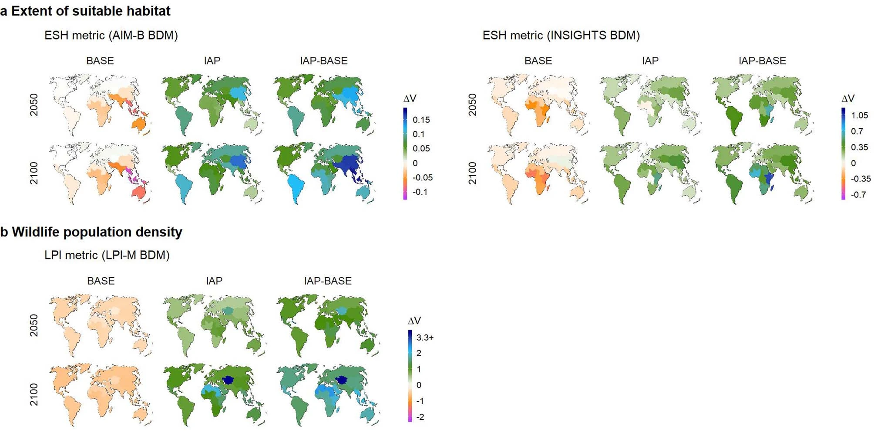
Notes:
Extended Data Fig. 2: Spatial patterns in projected changes in the value of biodiversity indicators for BASE and IAP scenarios (and the difference between the IAP and BASE scenarios) for the 17 IPBES subregions by 2050 and 2100 (compared to 2010 value).
a–e, The projected changes (mean across IAMs) for each of the eight combinations of BDIs and BDMs (Table 2) for which values at the scale of the IPBES subregions were available, grouped according to the five aspects of biodiversity. a, Extent of suitable habitat. b, Wildlife population density. c, Local composition intactness. d, Regional extinctions. e, Global extinctions. The FGRS indicator was estimated by the cSAR_US16 model only at the global scale.

Slide 30
Big shortcoming: uncertainty in initial land-use distribution (esp. Forest/ grassland mgmt.) varies across IAMs + causes BDIs (2010) to vary considerably among IAMs

Slide 31
Another shortcoming: other biodiversity aspects (e.g. phylogenetic + functional diversity) might require differet spatial allocation of conservation/ restoration efforts

Slide 32
And one more: other impacts like from climate change or through invasive species were not considered, although their importance might increase, potentially leading to synergistic effects with land use change

Slide 33
Boosting robustness:
Ensemble approach (IPBES)
Relative change in BDIs
Bootstrap resampling with replacement

Slide 34
Scenarios | Additional efforts to reverse trends in biodiversity
 | Supply side |  | Demand side |  | Increased conservation
 | Sustainably increased crop yields | Increased trade of agricultural goods | Reduced waste of agricultural goods from field to fork | Diet shift to a lower share of animal calories | Increased extent and management of protected areas | Increased restoration and landscape-level conservation planning
Baseline scenario
BASE scenario | − | − | − | − | − | −
Single-action scenarios
SS scenario | x | x | − | − | − | −
DS scenario | − | − | x | x | − | −
C scenario | − | − | − | − | x | x
Combined-action scenarios
C + SS scenario | x | x | − | − | x | x
C + DS scenario | − | − | x | x | x | x
IAP scenario | x | x | x | x | x | x
Notes:
IAP = integrated action portfolio

Slide 35
Biodiversity metric | Biodiversity model(s) | Definition of the biodiversity metric | Biodiversity aspect | Biodiversity metric | Biodiversity model(s) | Definition of the biodiversity metric
ESH | AIM-B and INSIGHTS | - Measures the extent of suitable habitat relative to 2010, geometrically averaged across species. - Ranges from 0 (no suitable habitat left for any species) to 1 (mean extent equal to that of 2010) or larger that 1 (mean extent larger than that of 2010). | Extent of suitable habitat | ESH | AIM-B and INSIGHTS | - Measures the extent of suitable habitat relative to 2010, geometrically averaged across species. - Ranges from 0 (no suitable habitat left for any species) to 1 (mean extent equal to that of 2010) or larger that 1 (mean extent larger than that of 2010).
LPI | LPI-M | - Measures the population size relative to 2010, geometrically averaged across species. - Ranges from 0 (zero population for all species) to 1 (mean population size equal to that of 2010) or larger than 1 (mean population size larger than that of 2010). | Wildlife population density | LPI | LPI-M | - Measures the population size relative to 2010, geometrically averaged across species. - Ranges from 0 (zero population for all species) to 1 (mean population size equal to that of 2010) or larger than 1 (mean population size larger than that of 2010).
MSA | GLOBIO | - Measures the compositional intactness of local communities (arithmetic mean of the relative abundance of species—truncated to 1—across all species that were originally present in comparison to an undisturbed state) relative to 2010. - Ranges from 0 (population of zero for all original species) to 1 (intactness equivalent to that of 2010) or larger than 1 (intactness closer to an undisturbed state than in 2010). | Intactness of the local species composition | MSA | GLOBIO | - Measures the compositional intactness of local communities (arithmetic mean of the relative abundance of species—truncated to 1—across all species that were originally present in comparison to an undisturbed state) relative to 2010. - Ranges from 0 (population of zero for all original species) to 1 (intactness equivalent to that of 2010) or larger than 1 (intactness closer to an undisturbed state than in 2010).
BII | PREDICTS | - Measures the compositional intactness of local communities (arithmetic mean of the relative abundance of species across all species that were originally present in comparison to an undisturbed state, truncated to 1) relative to 2010. - Ranges from 0 (population of zero for all original species) to 1 (intactness equivalent to that of 2010) to larger than 1 (composition closer to an undisturbed state than in 2010). | Intactness of the local species composition | BII | PREDICTS | - Measures the compositional intactness of local communities (arithmetic mean of the relative abundance of species across all species that were originally present in comparison to an undisturbed state, truncated to 1) relative to 2010. - Ranges from 0 (population of zero for all original species) to 1 (intactness equivalent to that of 2010) to larger than 1 (composition closer to an undisturbed state than in 2010).
FRRS | cSAR_CB17 | - Measures the proportion of species not already extinct or committed to extinction in a region (but not necessarily in other regions) relative to 2010. - Ranges from 0 (all species of a region extinct or committed to extinction) to 1 (as many species of a region are extinct or committed to extinction as in 2010) or larger (fewer species of a region are extinct or committed to extinction than in 2010). | Regional extinctions | FRRS | cSAR_CB17 | - Measures the proportion of species not already extinct or committed to extinction in a region (but not necessarily in other regions) relative to 2010. - Ranges from 0 (all species of a region extinct or committed to extinction) to 1 (as many species of a region are extinct or committed to extinction as in 2010) or larger (fewer species of a region are extinct or committed to extinction than in 2010).
FGRS | BILBI, cSAR_CB17 and cSAR_US16 | - Measures the proportion of species not already extinct or committed to extinction across all terrestrial areas, relative to 2010. - Ranges from 0 (all species extinct or committed to extinction at a global scale) to 1 (as many species are extinct or committed to extinction at a global scale as in 2010) or larger (fewer species are extinct or committed to extinction at a global scale than in 2010). | Global extinctions | FGRS | BILBI, cSAR_CB17 and cSAR_US16 | - Measures the proportion of species not already extinct or committed to extinction across all terrestrial areas, relative to 2010. - Ranges from 0 (all species extinct or committed to extinction at a global scale) to 1 (as many species are extinct or committed to extinction at a global scale as in 2010) or larger (fewer species are extinct or committed to extinction at a global scale than in 2010).
Notes:
IAP = integrated action portfolio

